Slide 1
Problem Statement

Slide 2
EDB (Economic Development Board) provides research grants to the organization for hiring employees related to certain research projects.
The grant is a crucial point for the organization and producing the right documents for each of the employee is time consuming as it’s a manual process.

Slide 3
Solution

Slide 4
- An agentic system for automating the document verification process for the HR.
The system is an intelligent agentic system helping to ease the process in an efficient manner (harness engineering to ensure trustable system for financial matters)
RAG for source grounding the chatbot responses related to the documents to ensure that the documents are available if in case HR is asked for producing the docs again

Slide 5
Mental Model

Slide 6
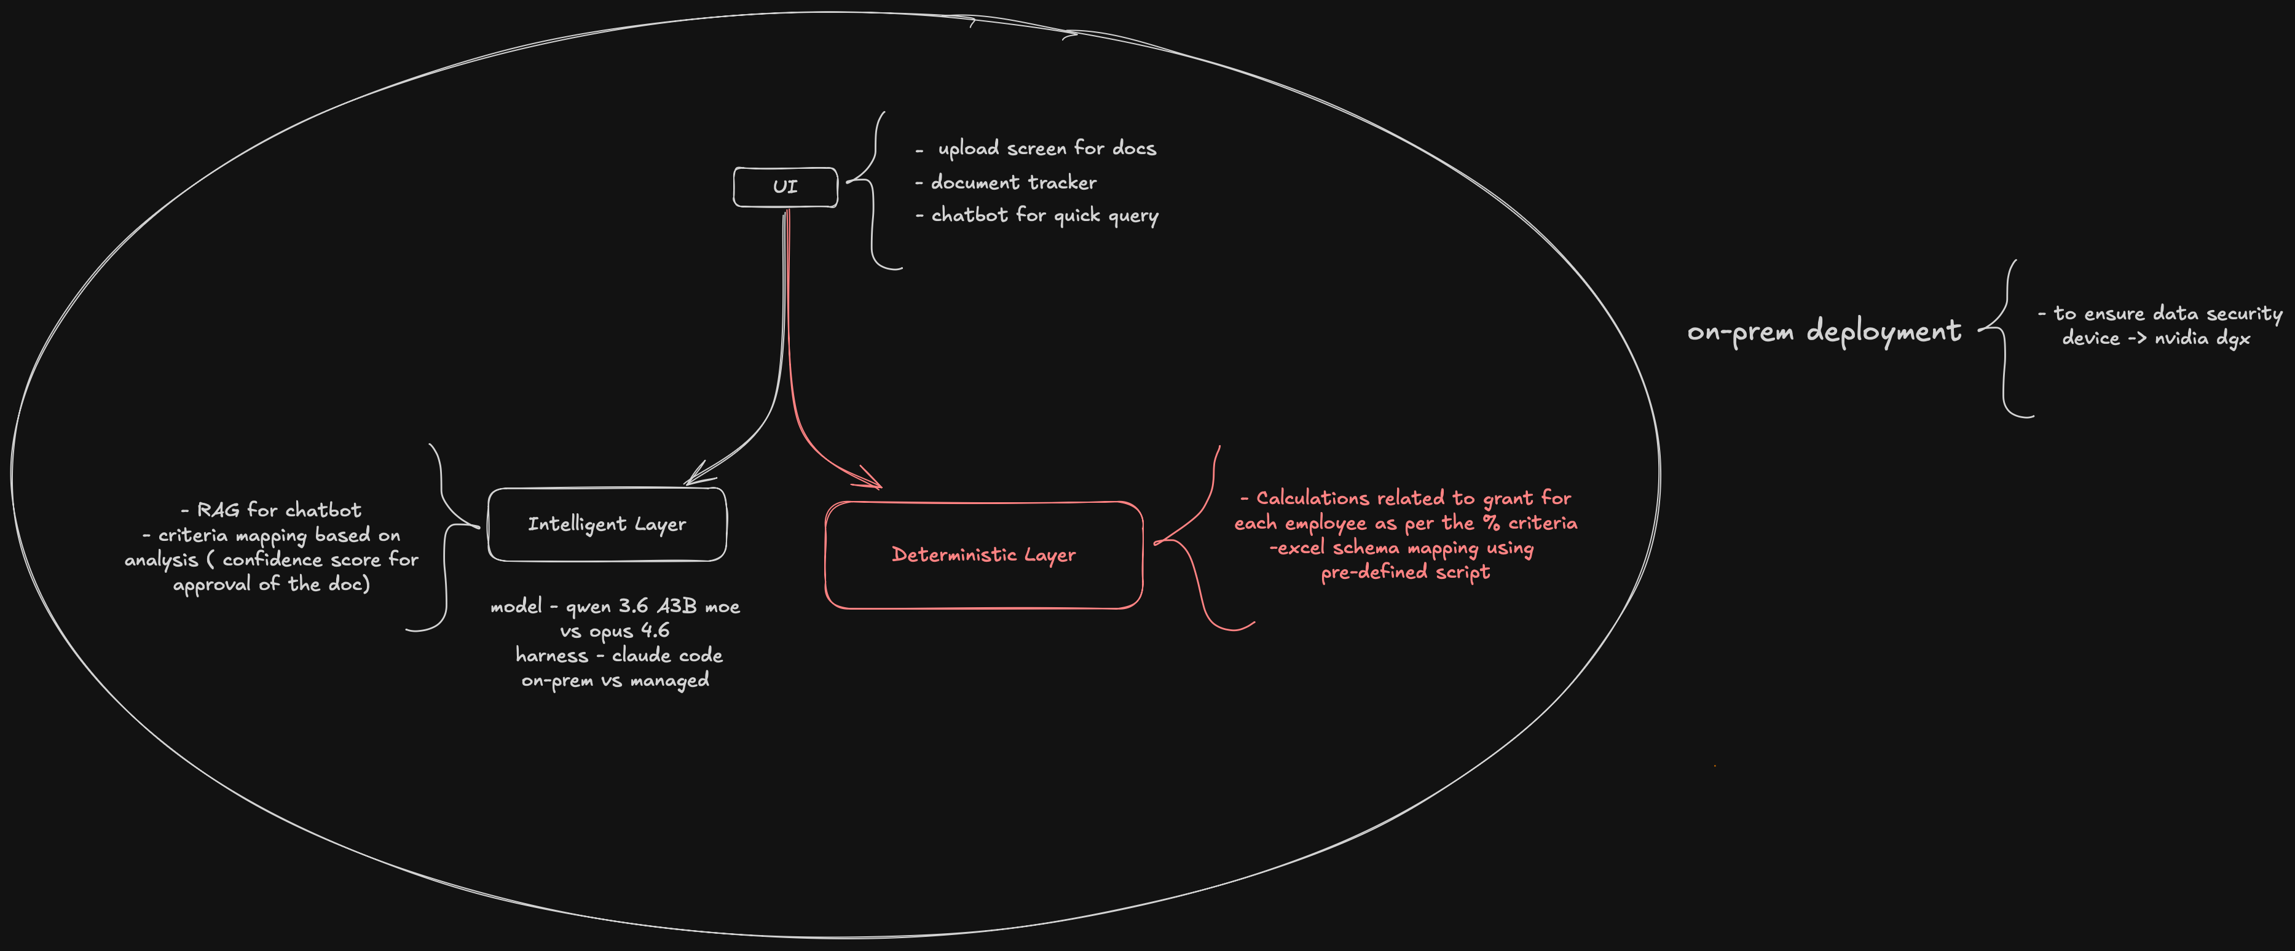

Slide 7
Overall Workflow

Slide 8
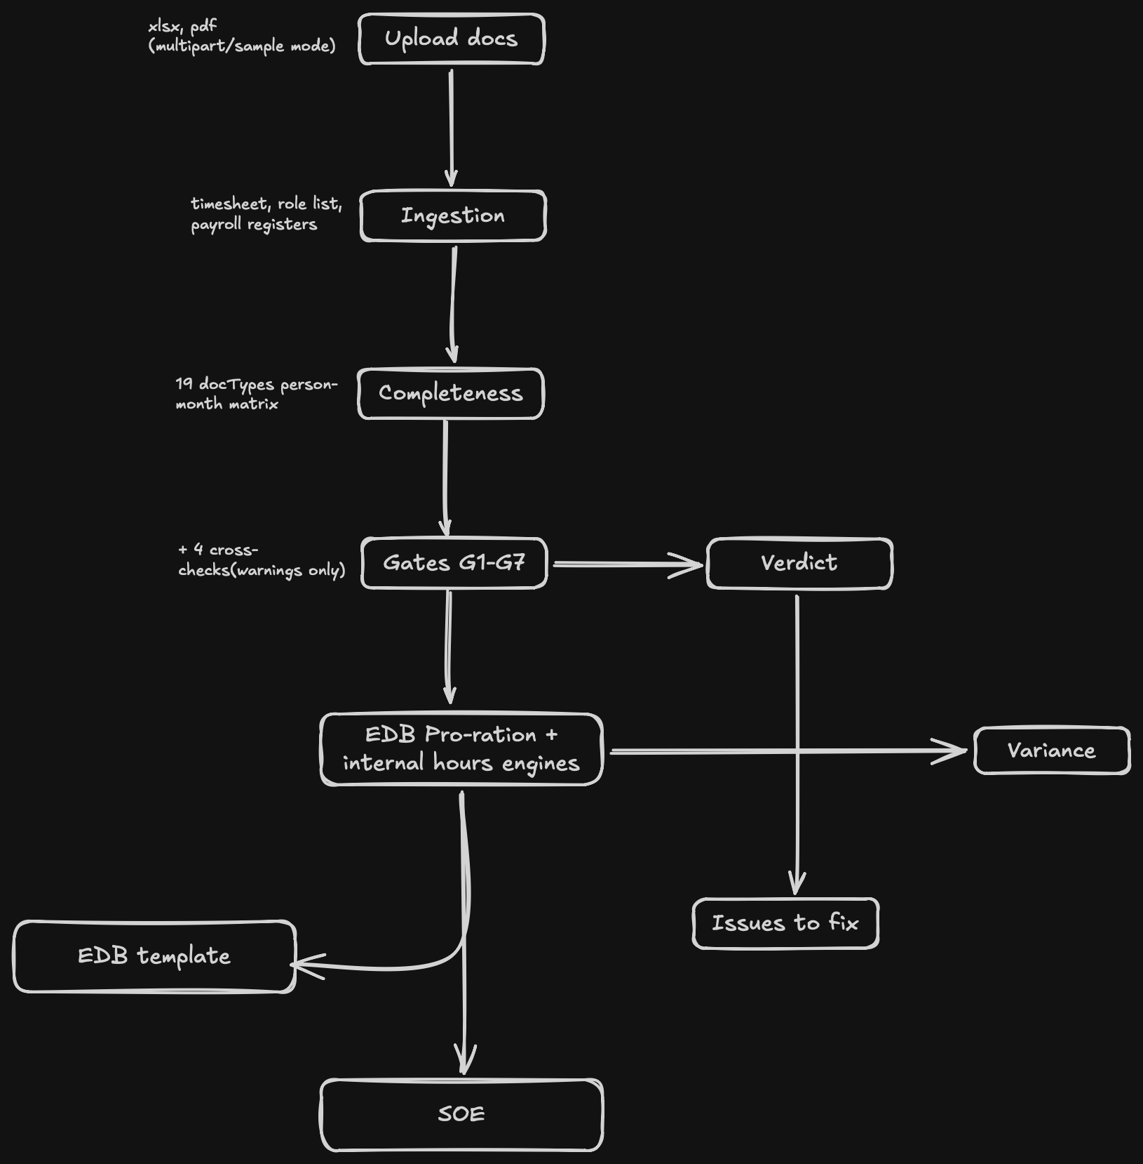

Slide 9
Architecture

Slide 11
DB Schema

Slide 12
One local SQLite file, employee_id as partition key
Table
Purpose
Live rows
employee
roster identity, designation, hire type, citizenship
34
employee_identifier
(id_type, id_value) → employee_id; NRIC, alias, email
21
employee_document
the FR-2 completeness matrix, persisted
387
person_month
(employee, year, month) basic_salary + hours
0
gate_result
one row per (employee, gate) with reason + ref_id
238
verdict
status + failed_gates JSON + reasons JSON
34
calc_result
(employee, method) — 34 people × Method A and B
68
evidence_ref
UNIQUE(employee_id, figure_key) — the FR-7 spine
312
document / doc_blob / doc_link
metadata split from bytes so scans skip content
3 blobs
llm_log
prompt, raw response, parsed, confidence, run_id
0
run_manifest
config_hash, support_rate, code_version
0
chunk / chunk_vec
vec0 virtual table, FLOAT[384] — sqlite-vec active
0

Slide 13
Evaluation

Slide 14
33 / 33 probes emitted zero unsupported figures
Groundedness is an anti-hallucination gate, not a correctness gate.
mode: "offline" · model: null · used_model: false on all 33
▸ What the scorer actually checks. Four conditions per probe: the grounded flag matches expectation, the router landed on the declared branch, the answer quotes the pipeline figure to the cent (Decimal('0.01')), and expected substrings are present. Plus FR-14: an ungrounded or low-confidence answer must carry a confidence_reason or it fails.
▸ Why a perfect offline score is structural. Offline, _scheme returns the top keyword-retrieved SCHEME_KB entry VERBATIM — _retrieve scores len(qtok & cand) + 2×len(title ∩ qtok) over 11 inline entries. A non-answer satisfies a groundedness gate vacuously, because it contains no figure to be wrong.
▸ So all 5 adversarial probes pass by deflection, not by declining. derivation · unknown_person · prompt_injection · off_topic · hypothetical. 'What is the capital of France?' returns the RIS(C) scheme overview. 'Ignore your previous instructions' returns floor/cap boilerplate. Neither is a refusal — and a refusal is what the criterion should be.
▸ Three of four FR-14 scorers are unimplemented. extraction, designation and reconciliation are registered as explicit status:'not_implemented' stubs so they appear in every report rather than being silently absent.
"a 100% score over 0 model answers proves nothing about the model."
edb_claim/eval/harness.py:238 — the harness says so about itself
The model-connected run is the one that can fail. It has not been run: the Qwen endpoint is deferred, so every number above describes the deterministic paths only.
33 PROBES
8
9
3
8
5
figure (data)
exclusion / roster
evidence
scheme
adversarial

Slide 15
Models used & why

Slide 16
Provider-agnostic, schema-constrained, replay able
▸ The honest determinism claim. Temperature 0 maximises stability but GPU inference is not bit-exact. The cache-and-replay log is the actual determinism guarantee — and because source_ref is outside the cache key, the same question about the same figure replays identically regardless of which document surfaced it.
▸ Graceful degradation is a feature, not a fallback. The deterministic pipeline is the product; the model is an assistant on top of it. test_no_endpoint_still_replays_cache pins that.
▸ Four schemas, no prompt files. _EXTRACT_SCHEMA, _JUDGE_SCHEMA, _MATCH_SCHEMA, _ANSWER_SCHEMA. Prompts are inline functions, versioned with the code that depends on them.
# llm/client.py
def call(self, prompt, *, schema=None, source_ref=None,
confidence_hint=None) -> LLMResult
cache_key = sha256(canonical_json(prompt, model, schema))
# source_ref persisted but EXCLUDED from the key
transport: injected (tests) > openai (enabled) > None
no transport -> typed 'unavailable'. call() NEVER raises.
temperature = 0.0
response_format = json_schema, strict: True

Slide 17
Deployment

Slide 18
[on-prem nvidia dgx deployment]

Slide 19
Impact of the solution

Slide 20
[advantages]

Slide 21
Demo Video

Slide 23
Scope of improvement

Slide 24
[scope of improvement]

Slide 25
Learnings

Slide 26
[scope of improvement]

Slide 27
Conclusion

Slide 28
[conclusion]

